Slide 1
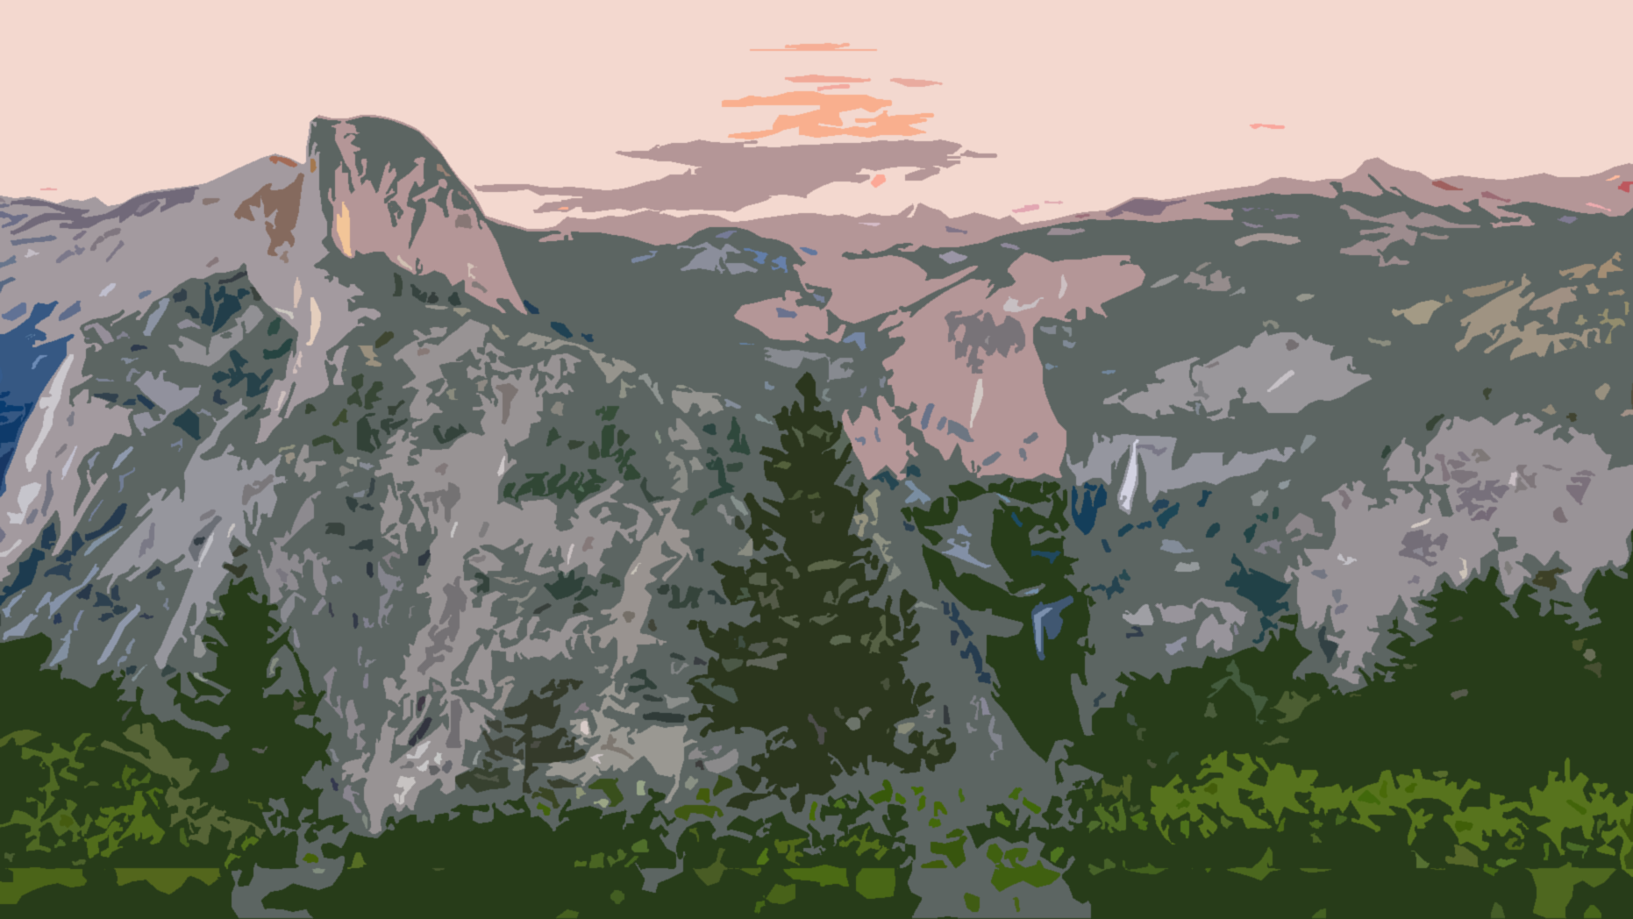
Natural Wonders Answers

Slide 2
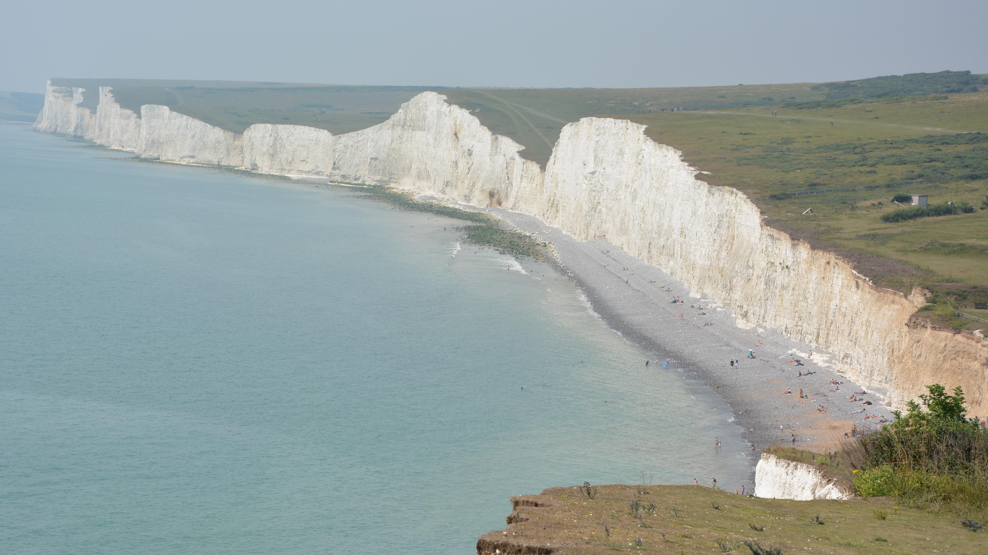

1) Cliffs of Dover
United Kingdom

Slide 3
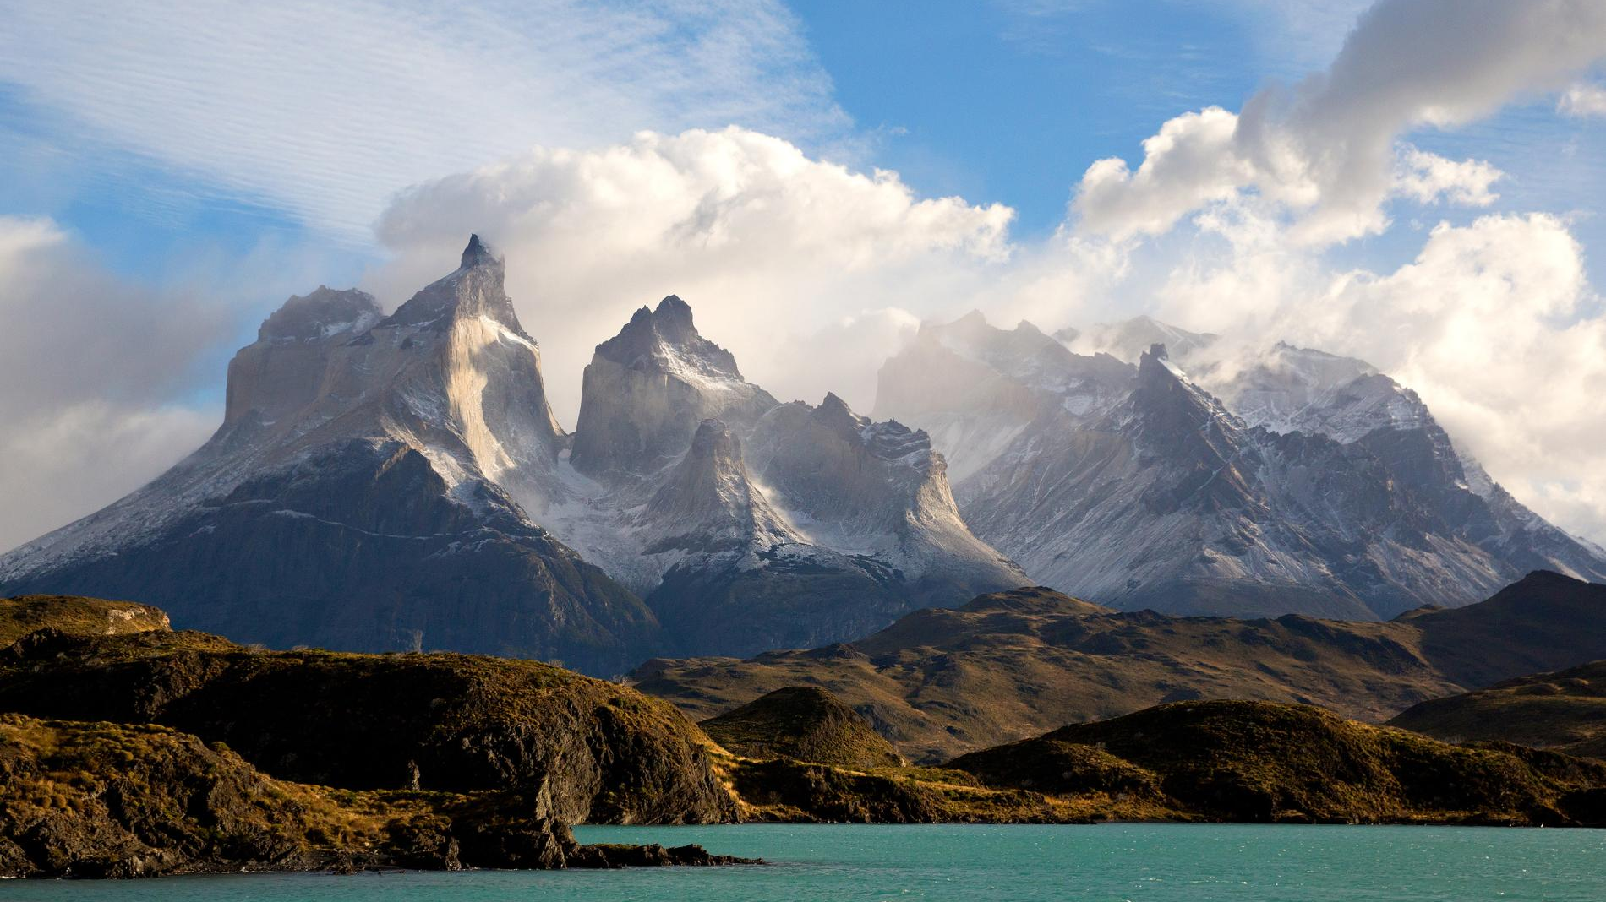

2) Torres del Paine
Chile

Slide 4
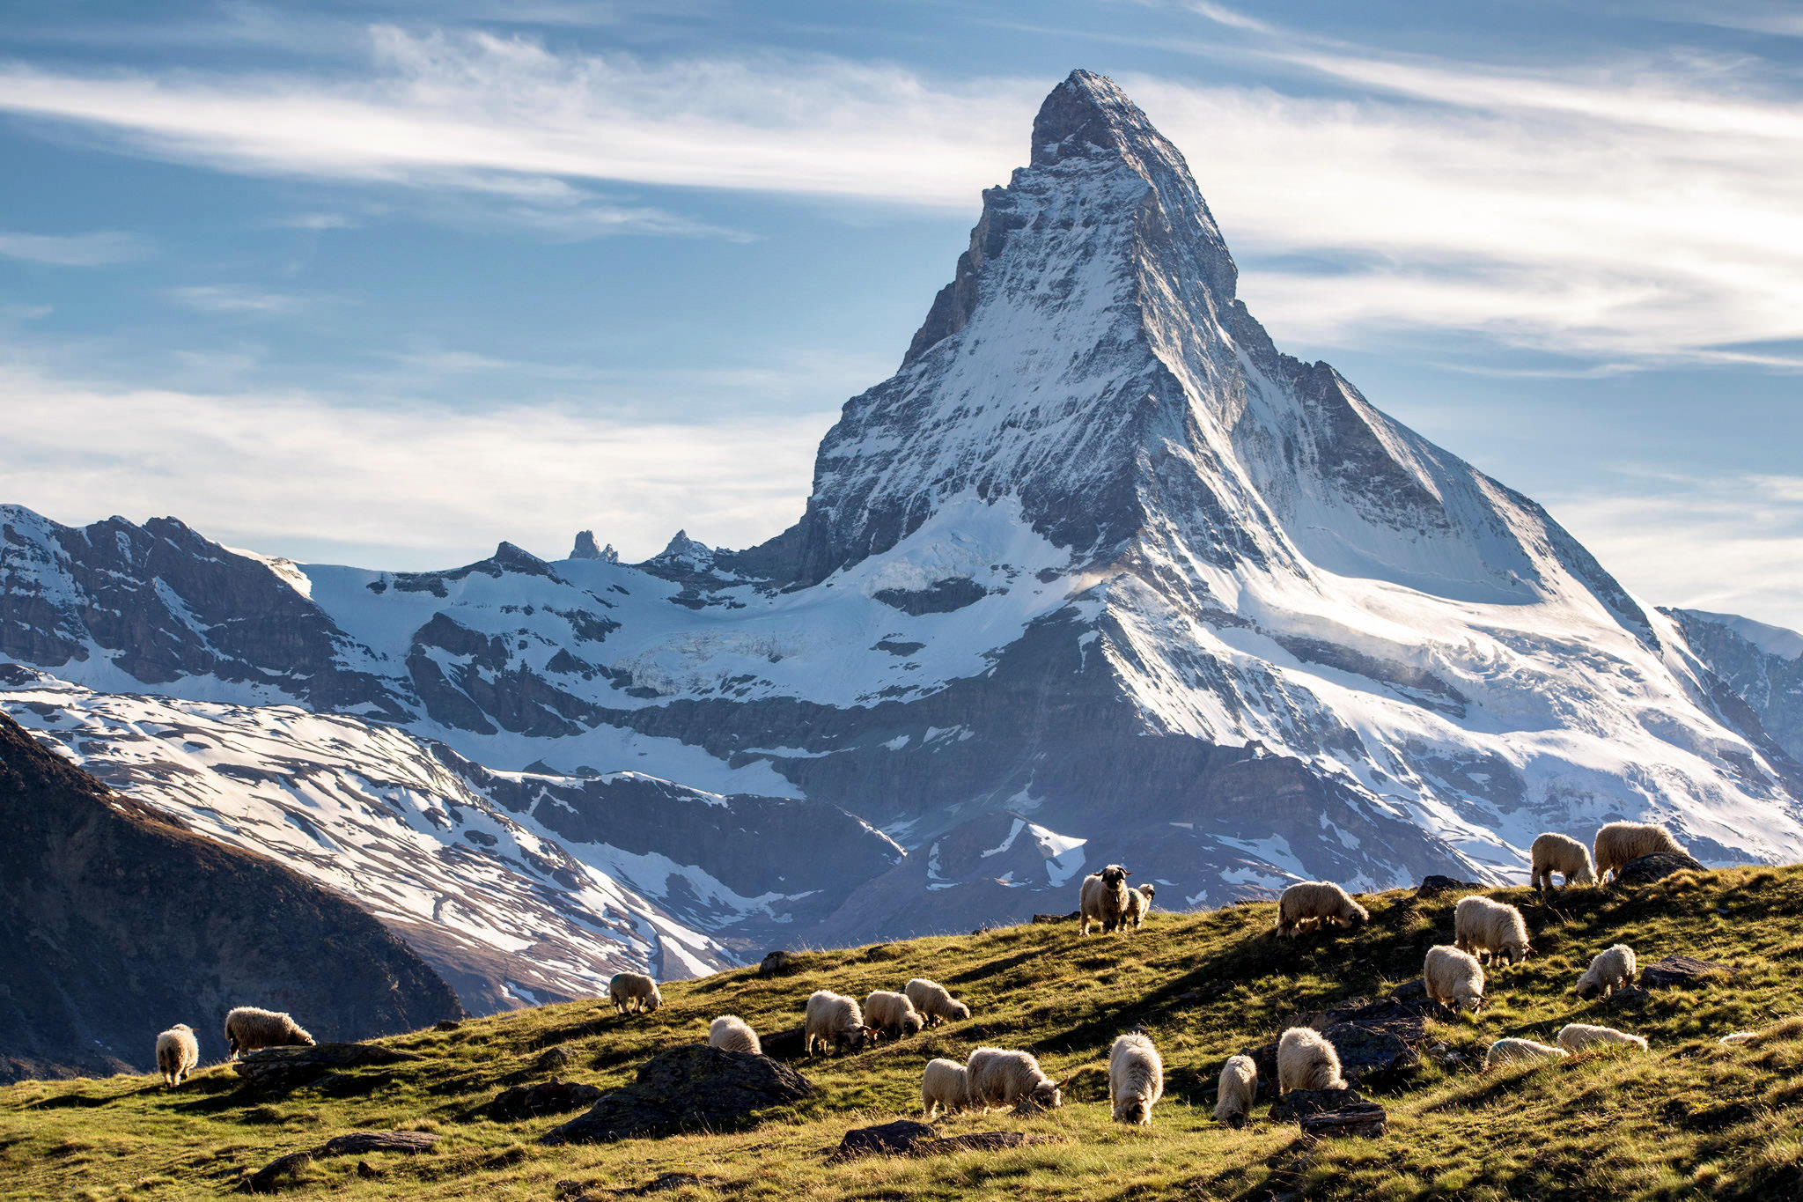

3) Matterhorn
Switzerland

Slide 5
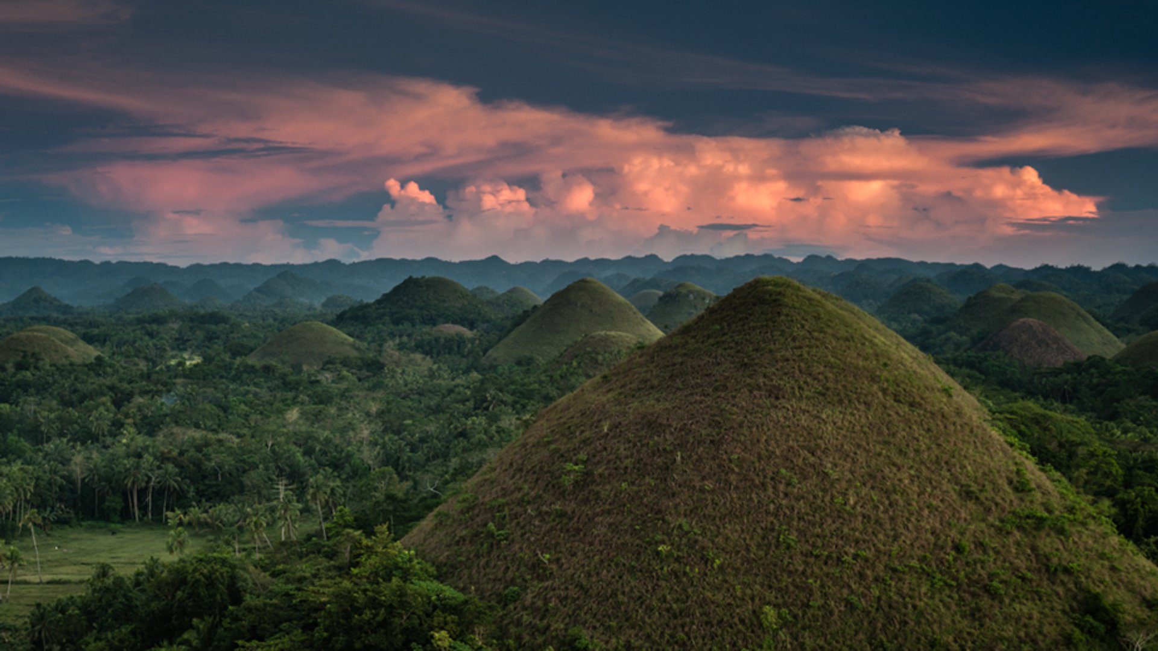

4) Chocolate Hills
The Philippines

Slide 6
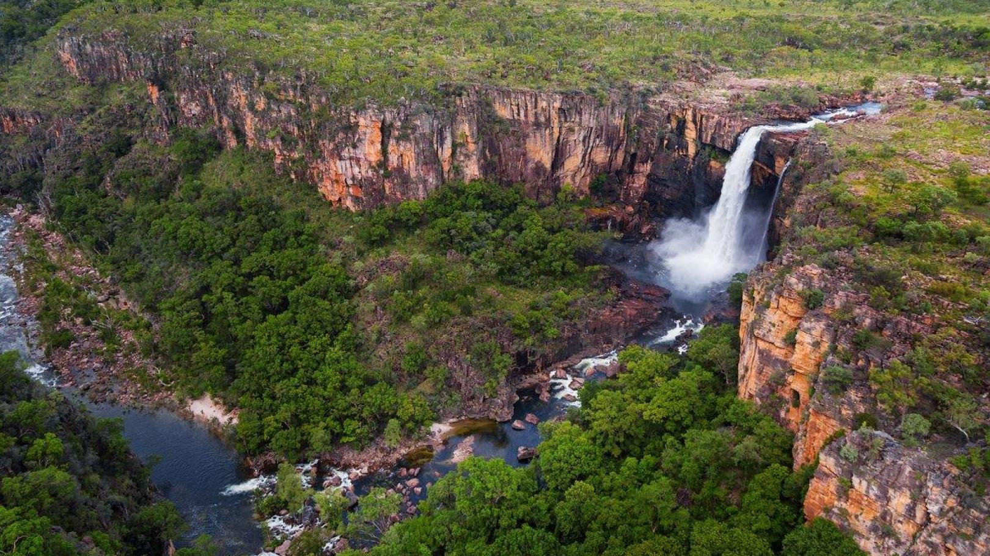

5) Kakadu
Australia

Slide 7
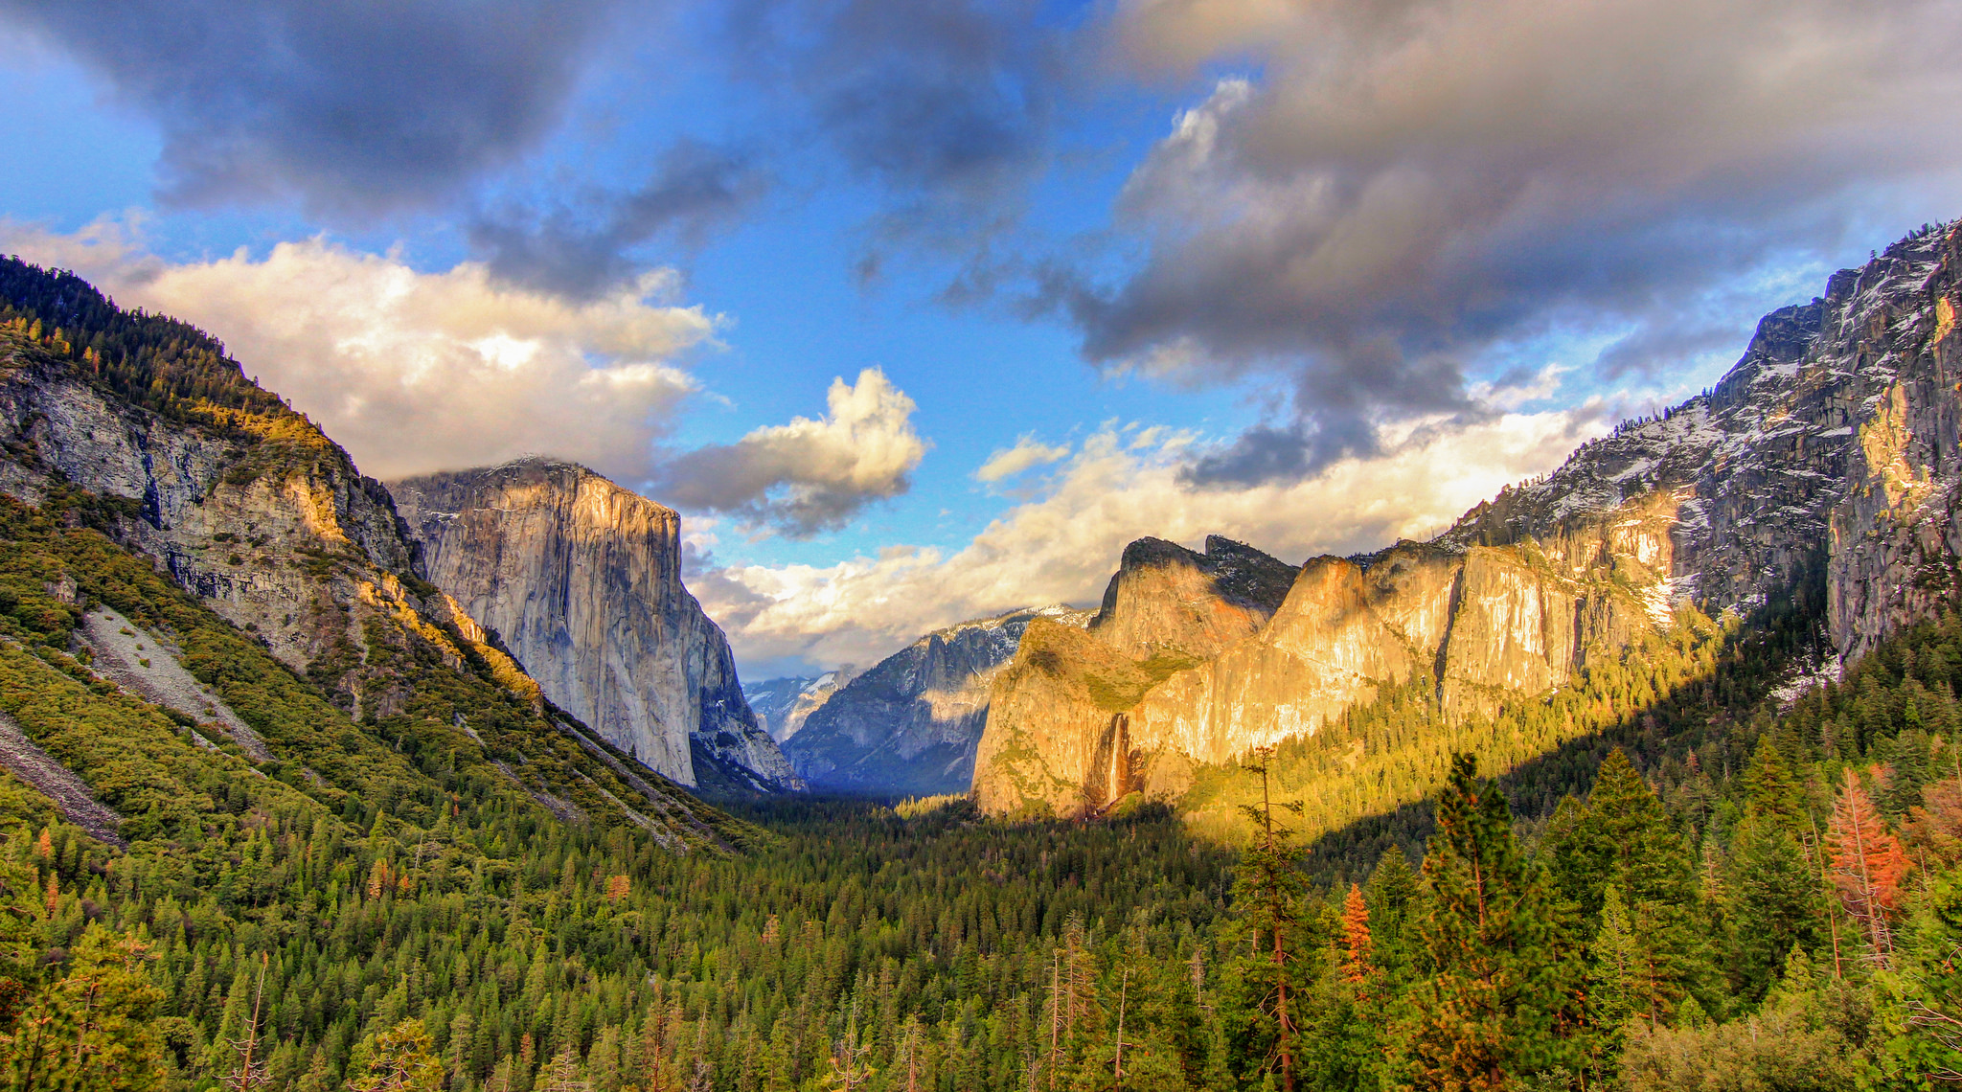

6) Yosemite
United States – California

Slide 8
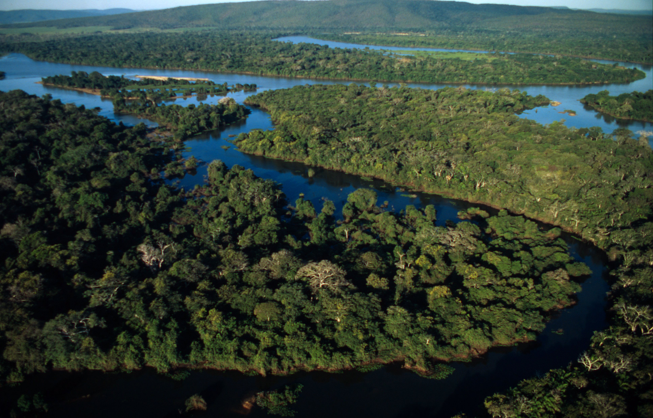

7) Pantanal
Brazil

Slide 9
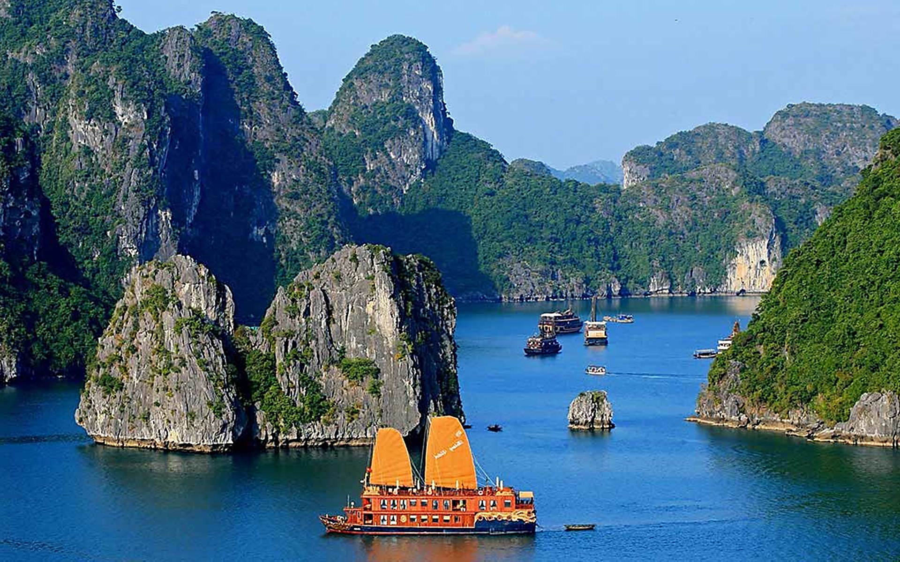

8) Ha Long Bay
Vietnam

Slide 10
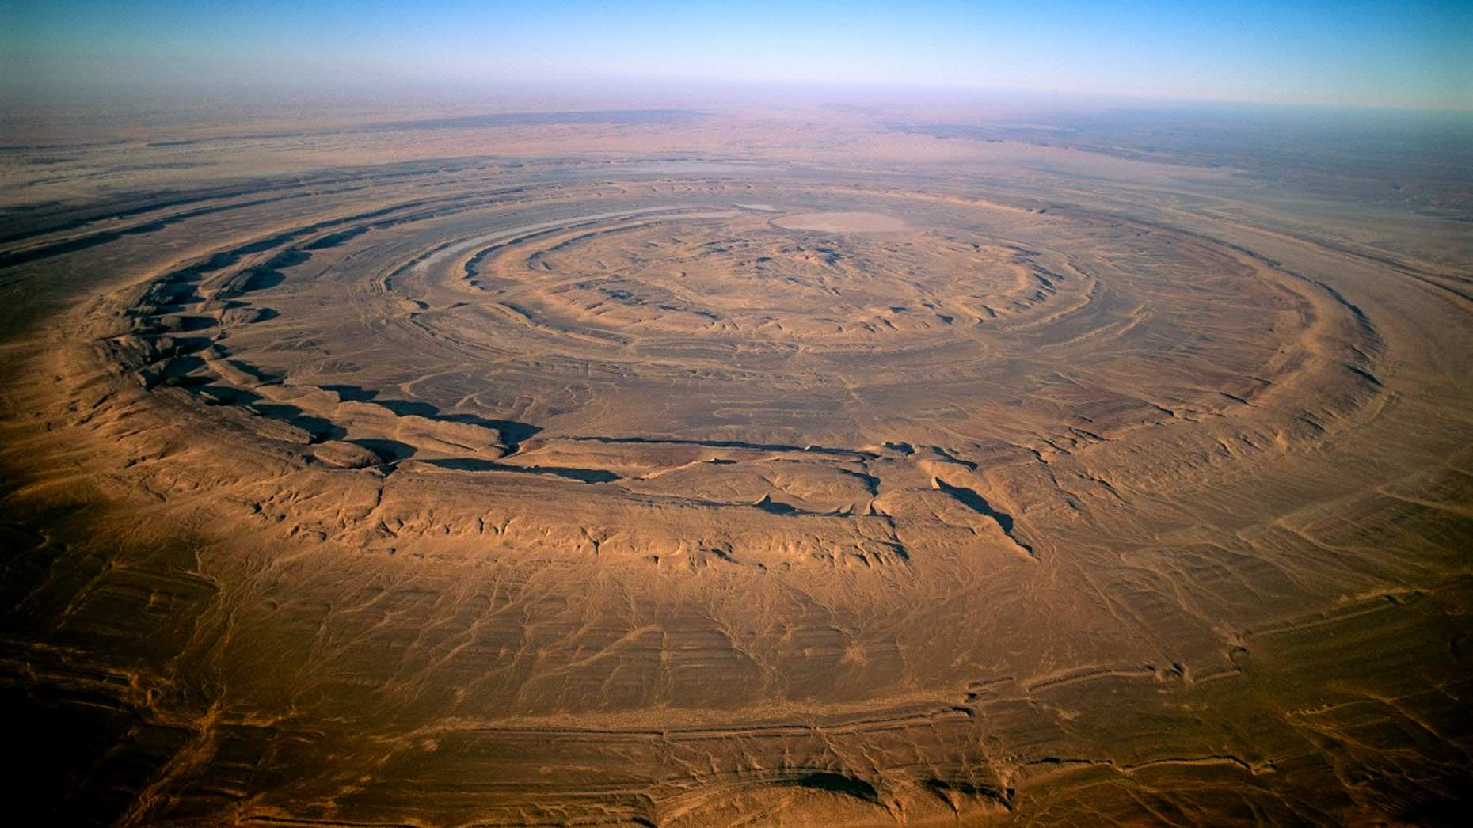

9) Eye of the Sahara
Mauritania

Slide 11
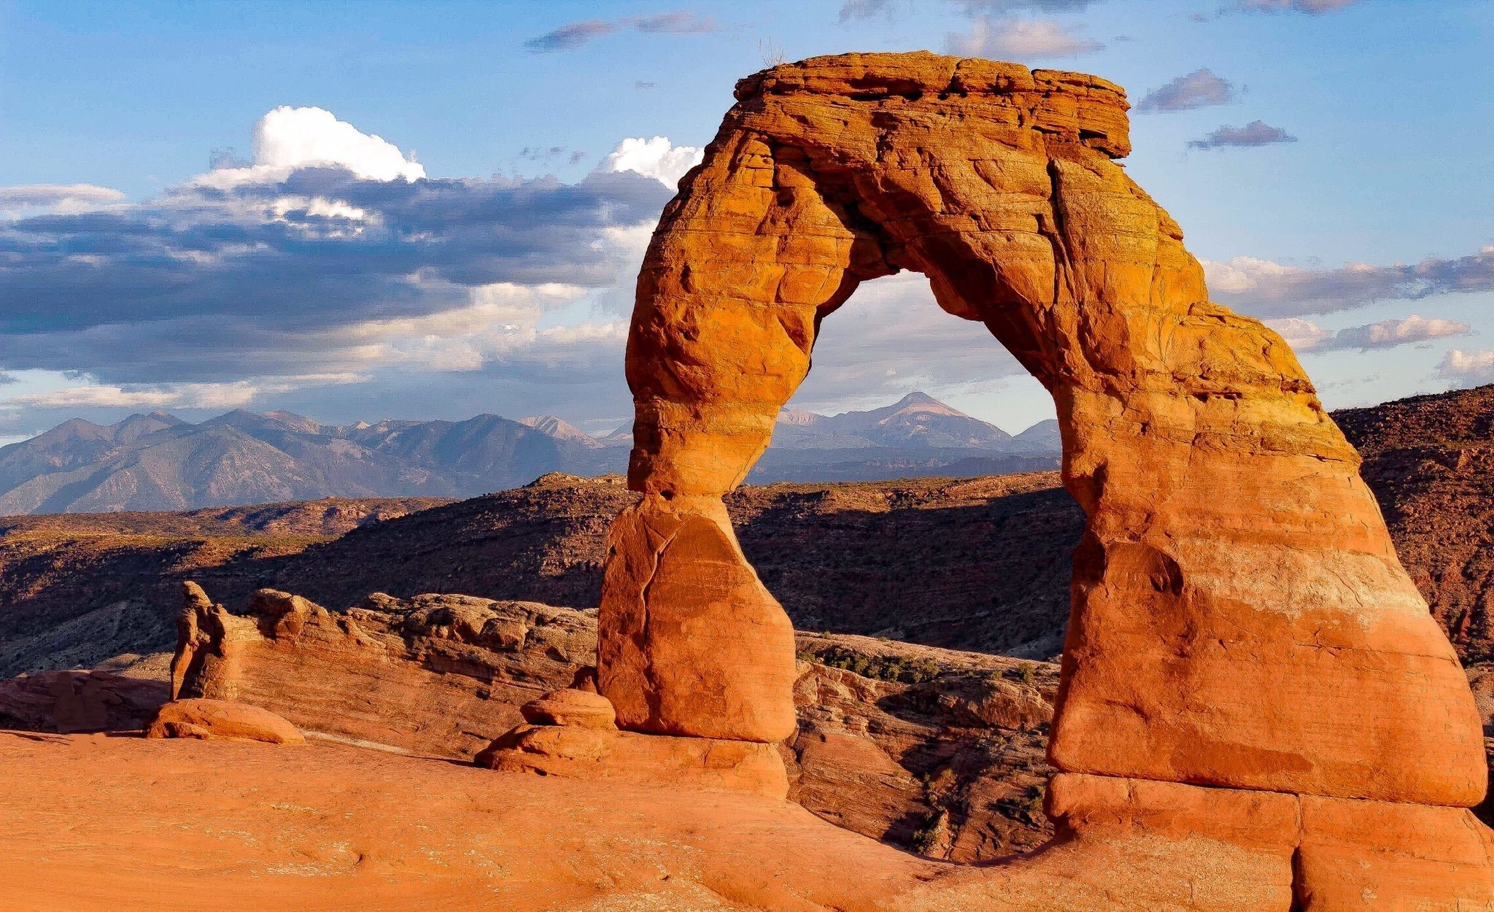
10) Delicate Arch
United States – Utah

Slide 12
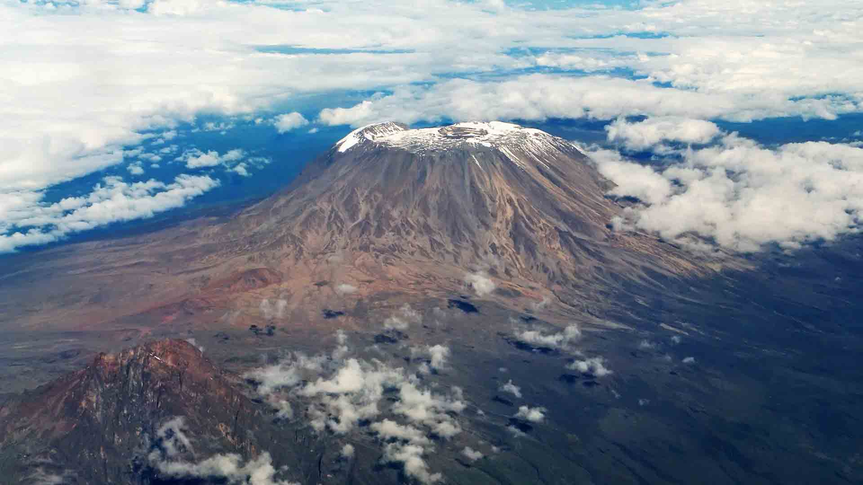

11) Mount Kilimanjaro
Tanzania

Slide 13
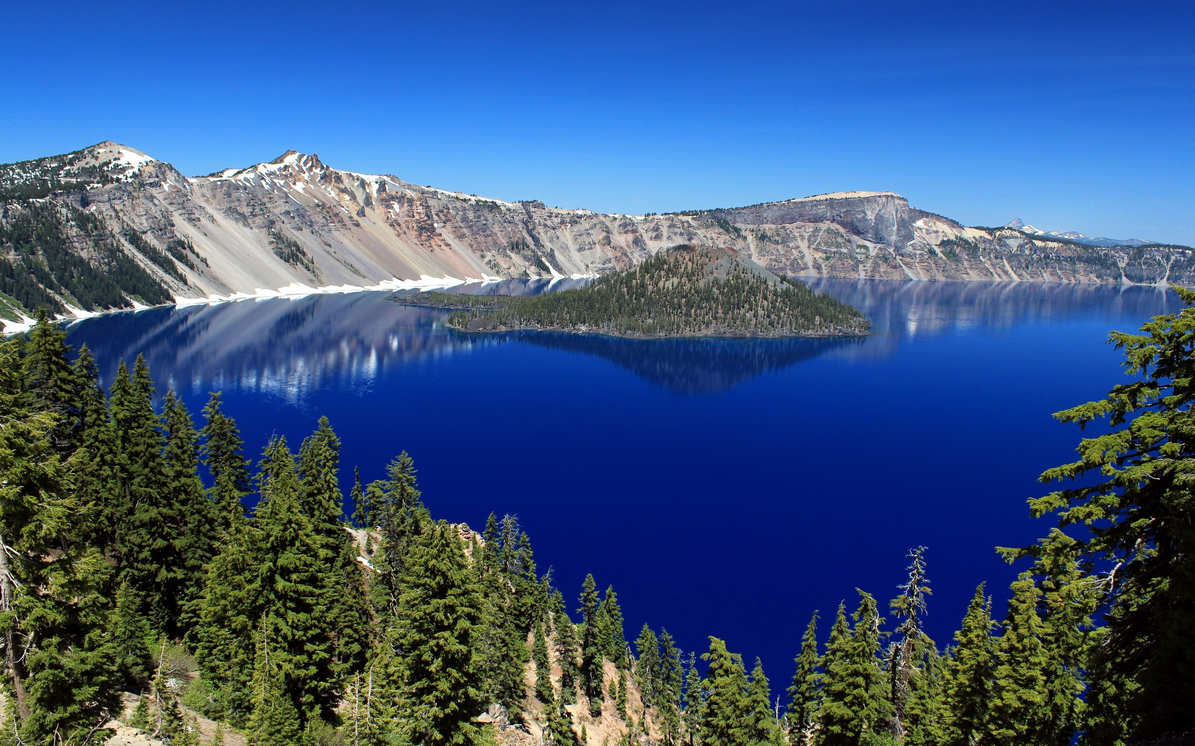
12) Crater Lake
United States – Oregon

Slide 14
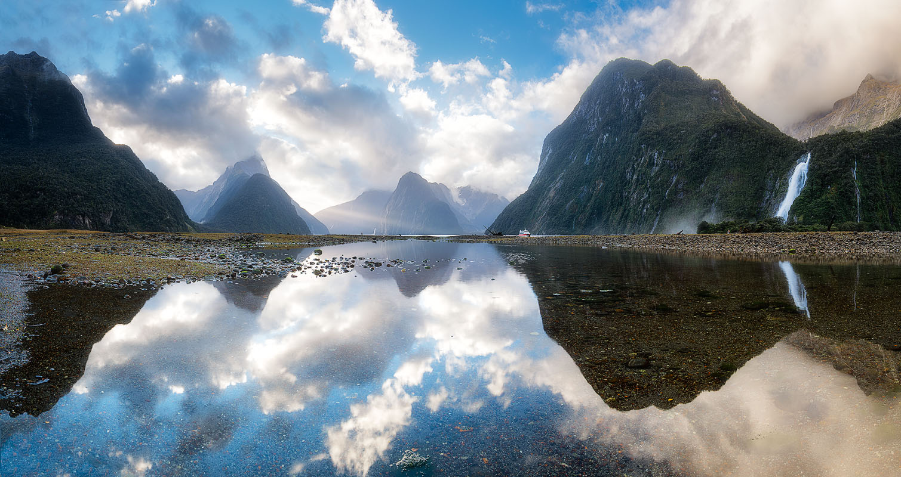

13) Piopiotahi
New Zealand

Slide 15
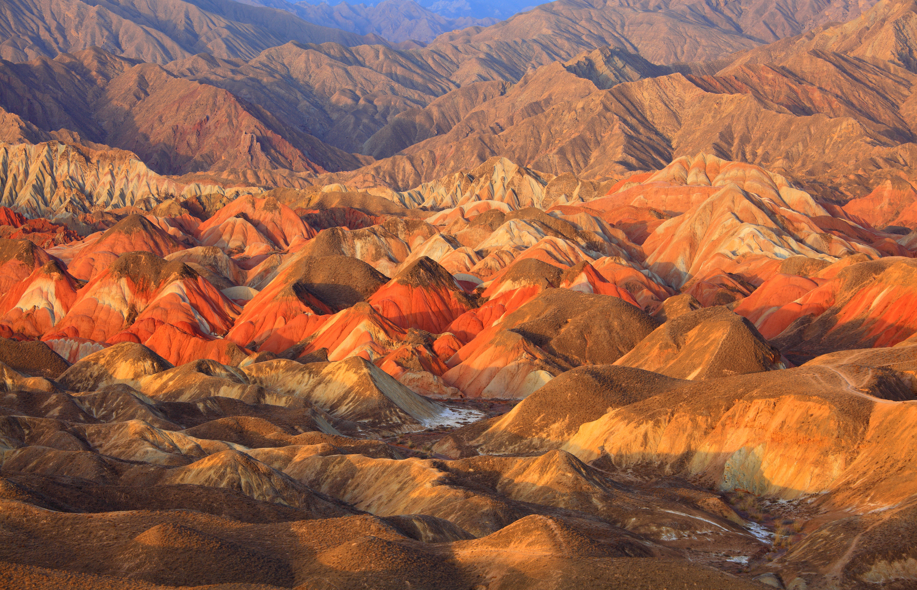

14) Zhangye Danxia
China

Slide 16
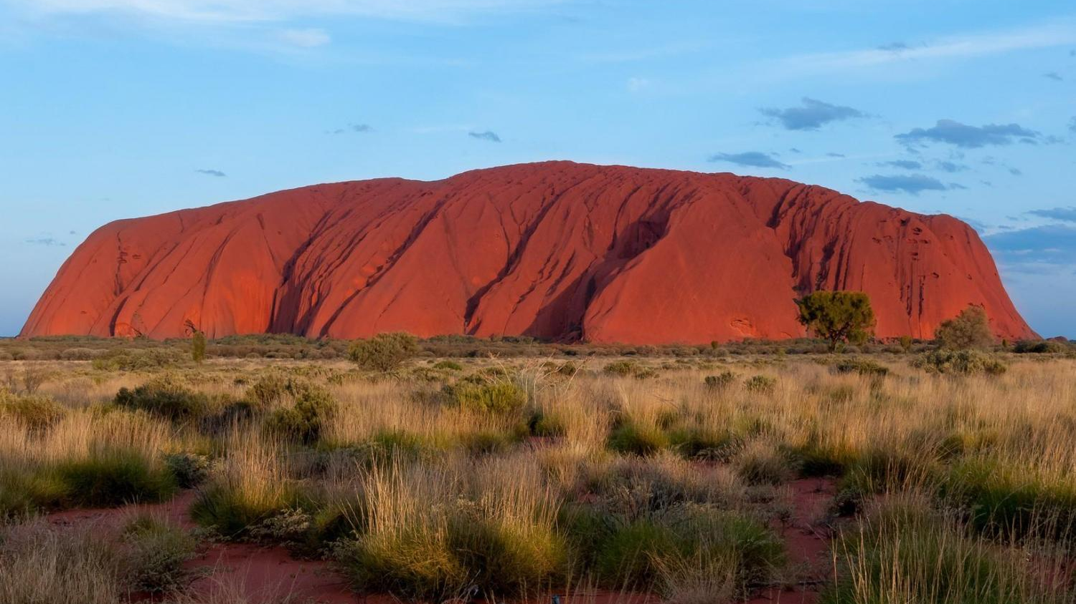
15) Uluru
Australia

Slide 17
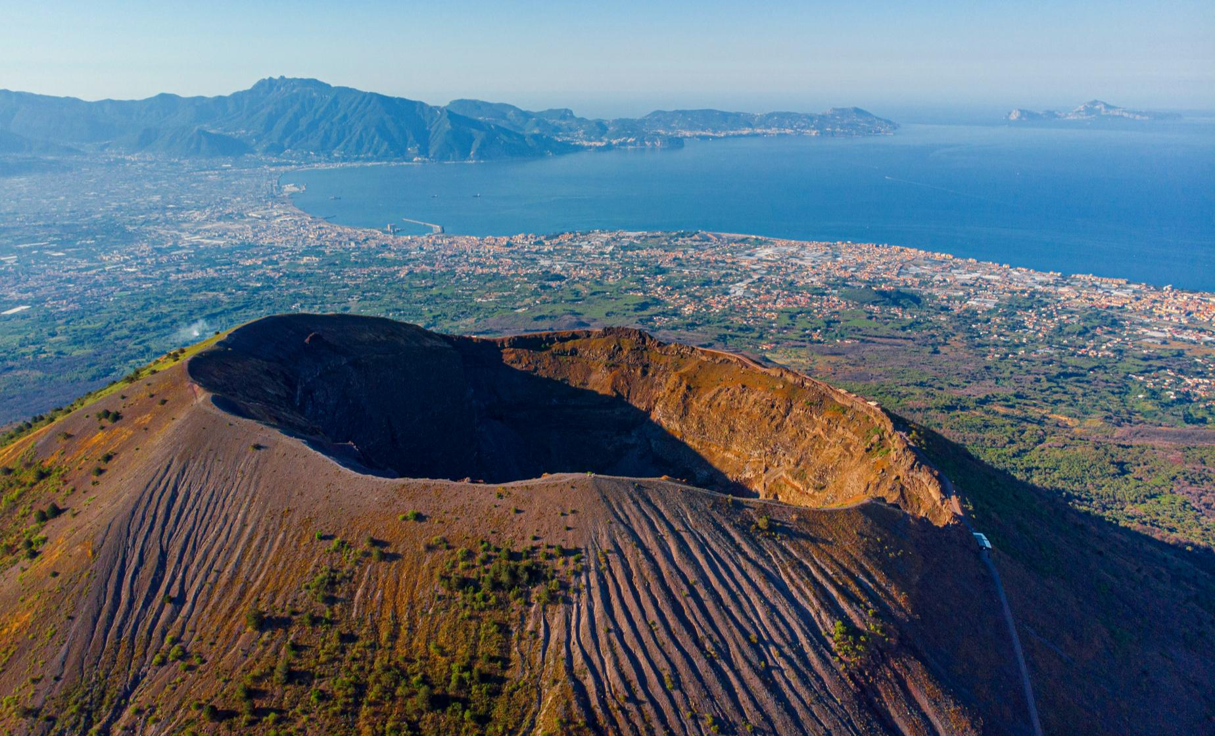

16) Mount Vesuvius
Italy

Slide 18
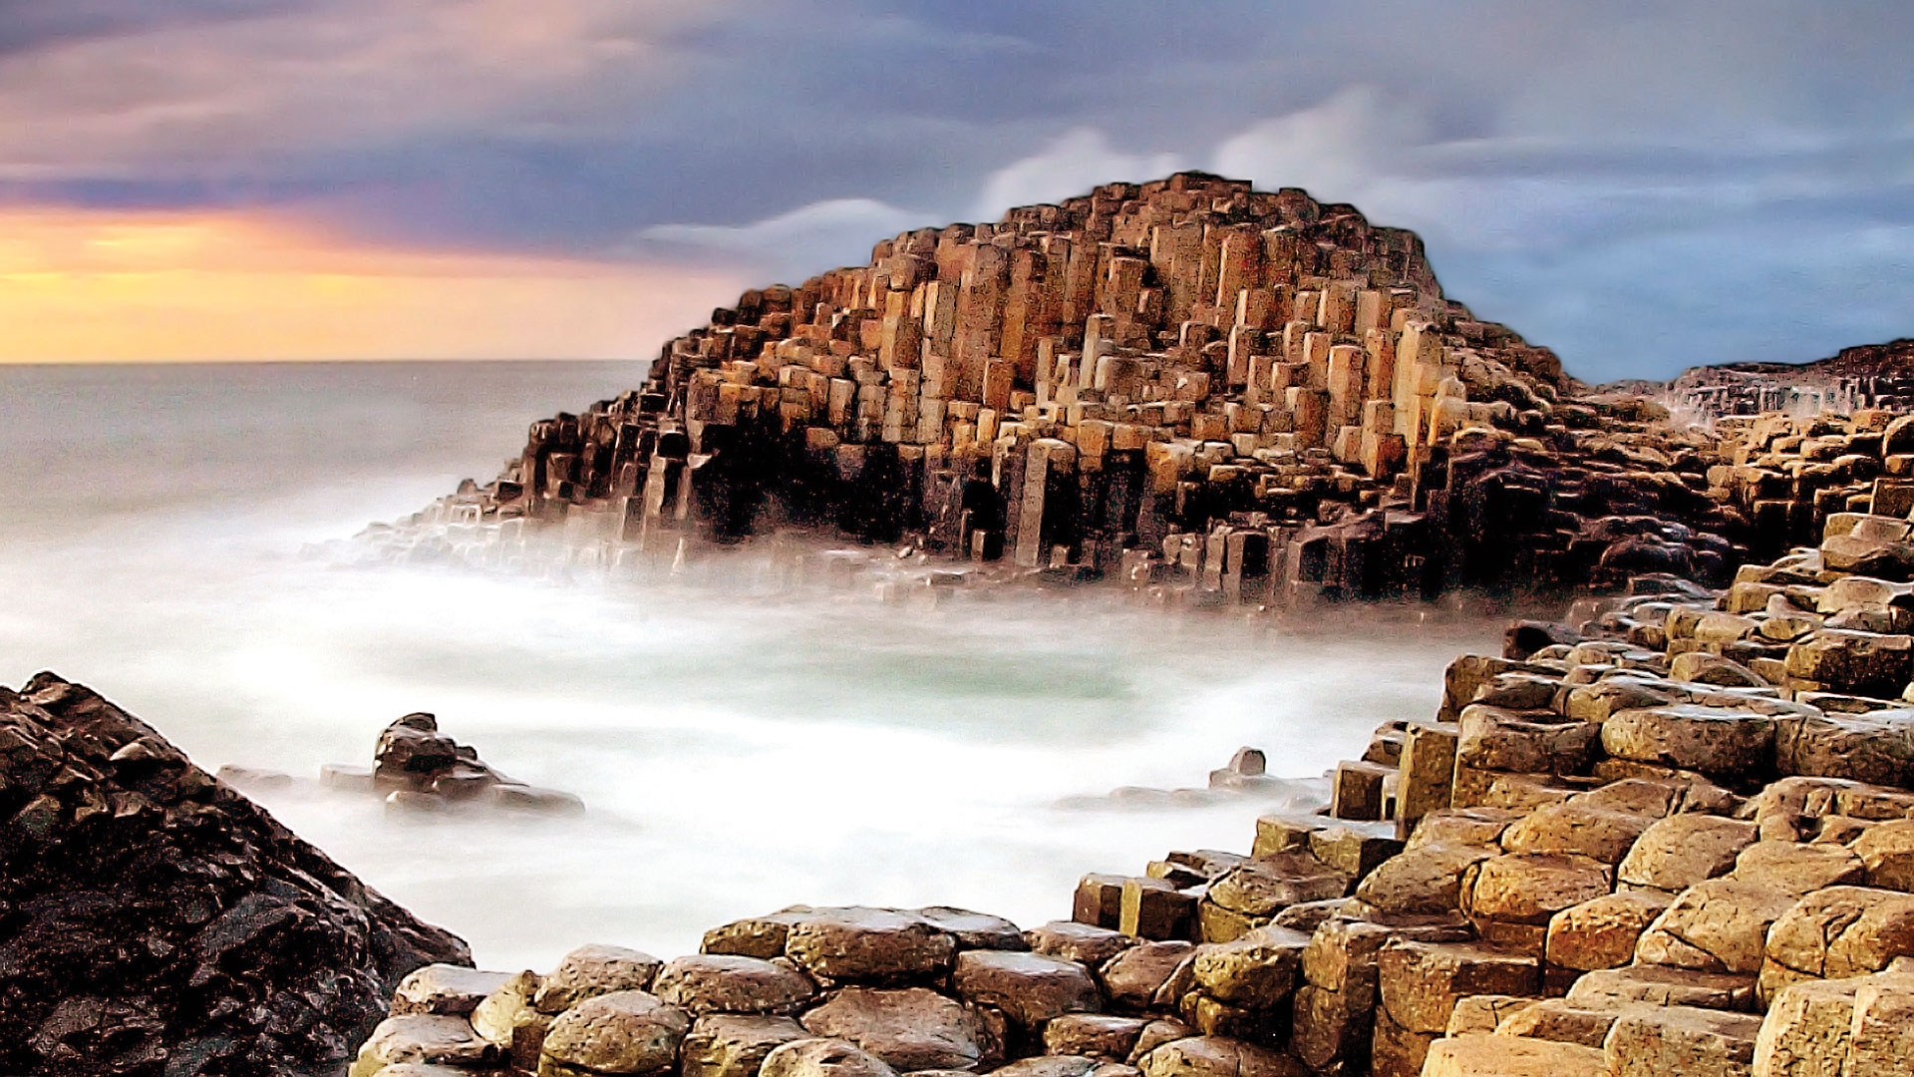
17) Giant’s Causeway
United Kingdom – Northern Ireland

Slide 19
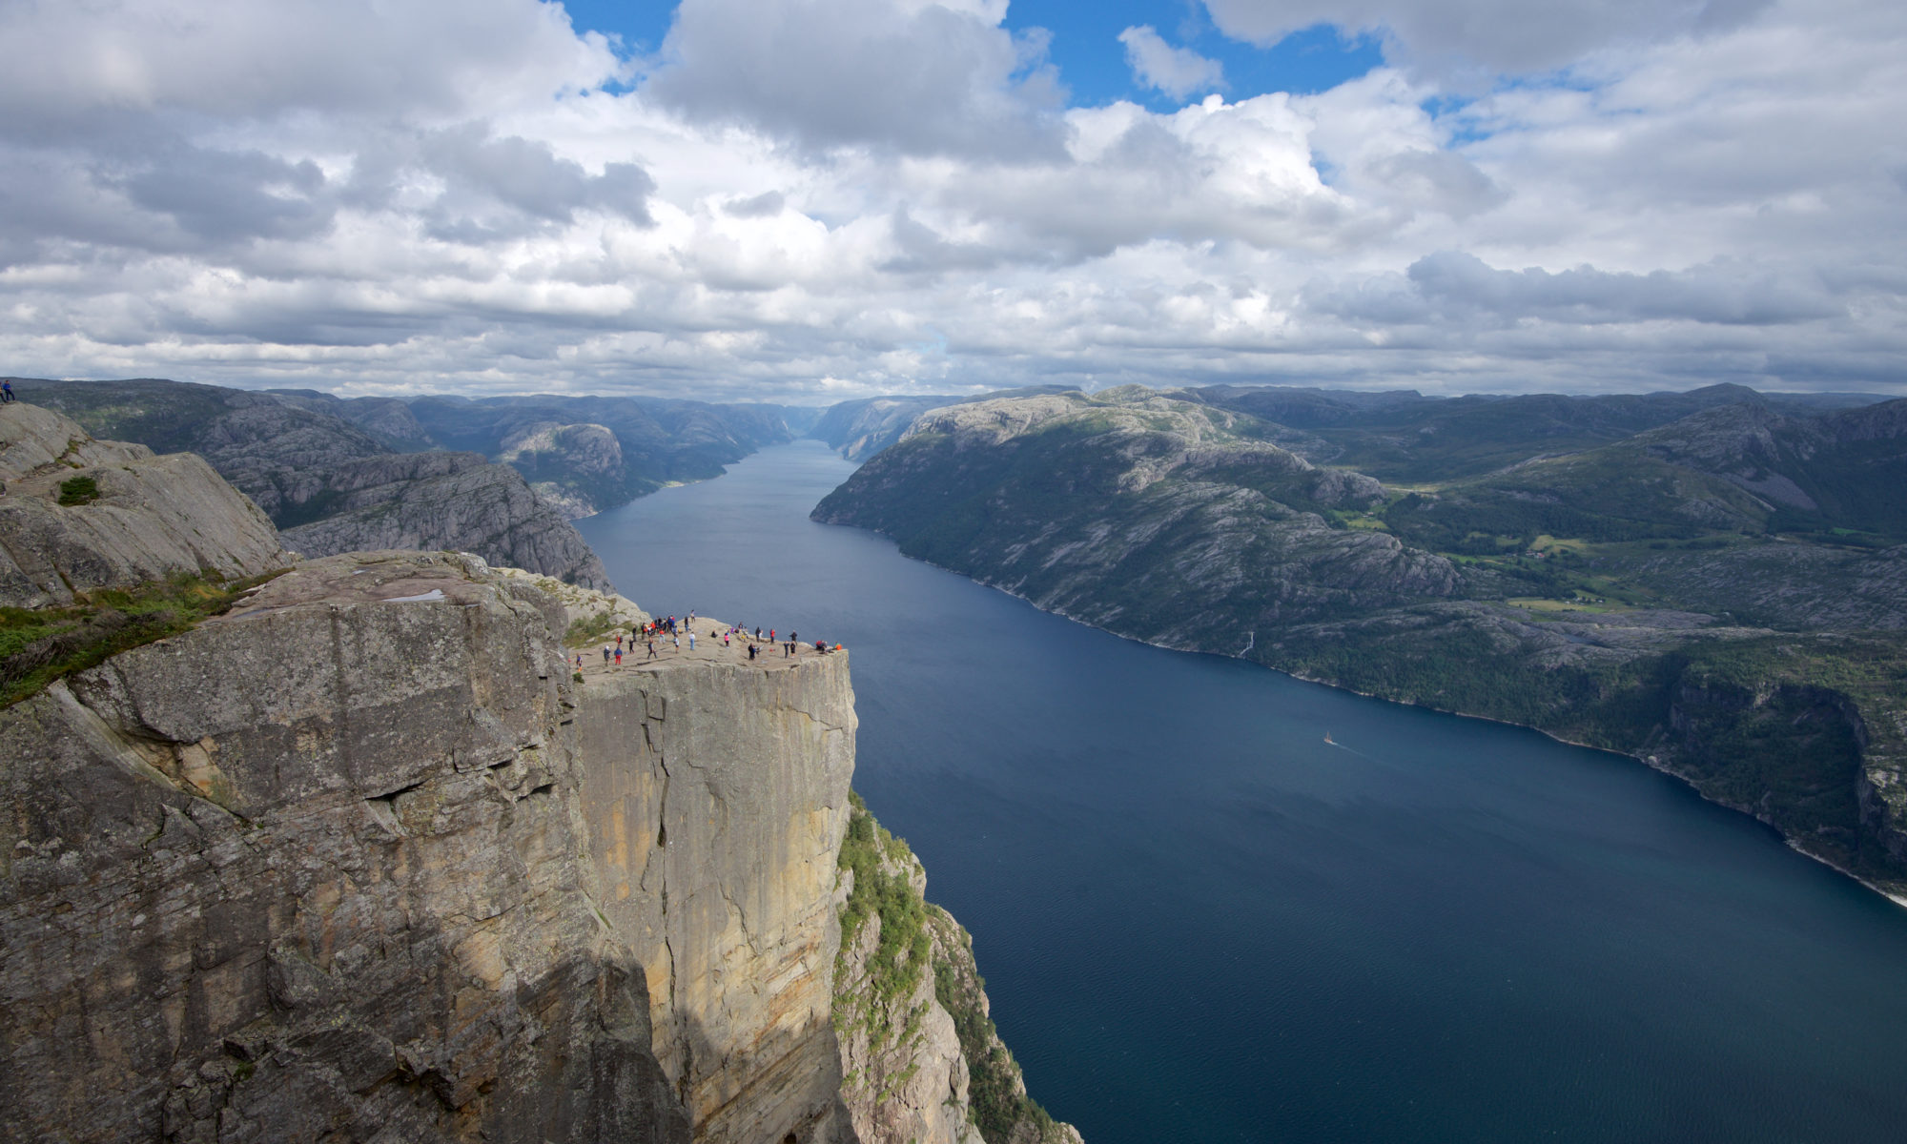

18) Lysefjord
Norway

Slide 20
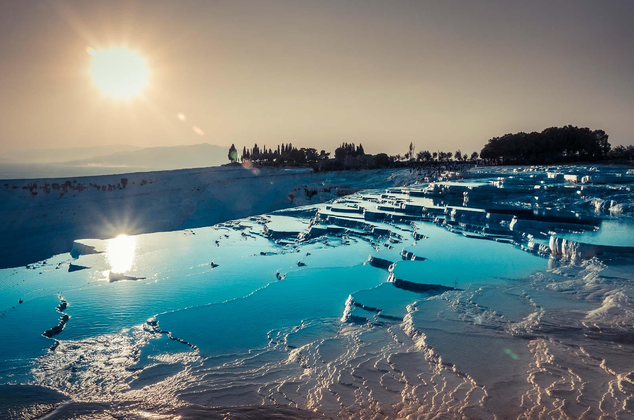

19) Pamukkale
Turkey

Slide 21
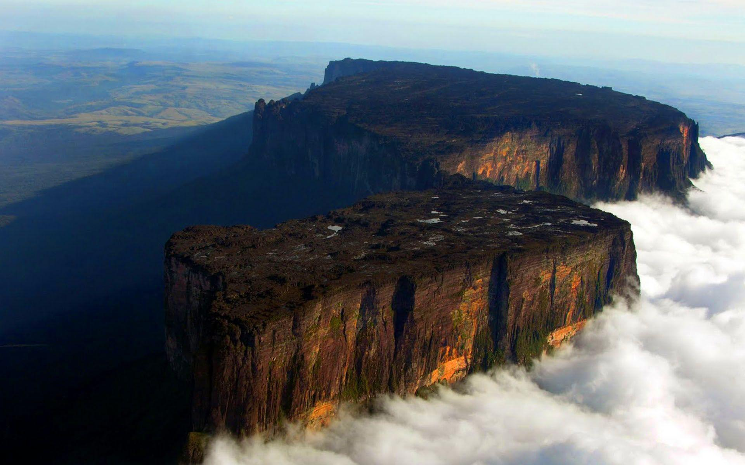

20) Mount Roraima
Venezuela, Guyana & Brazil

